Slide 1

Introduction to Software Business Product management
Week 2 Day 1
Led by: Emily Crose
for
Oakland University

Slide 2

Week 1 recap

Slide 3

Questions From Last Week?

Slide 4

Securing & Encrypting data

Slide 5

Hashing
Notes:
Last week, we talked about “hashing” Does anyone remember the context of what we discussed hashing in?
We talked about hashing in the context of CRCs on information sent over a network.

Slide 6
Value of hashing
Layer of validation of data
Secures both ends of transmission
Anyone can validate!
Protects original secret
irreversible

Slide 7
Popular Hashing algorithms
MD5
SHA-1 (compromised)
SHA-2
SHA-3
LM/NTLM hash (for Windows passwords)
Notes:
9ece086e9bac491fac5c1d1046ca11d737b92a2b2ebd93f005d7b710110c0a678288166e7fbe796883a4f2e9b3ca9f484f521d0ce464345cc1aec96779149c14

Slide 8

Let’s try some hash!
https://gchq.github.io/CyberChef/

Slide 9

What is encryption?

Slide 10
Encryption history

Slide 11
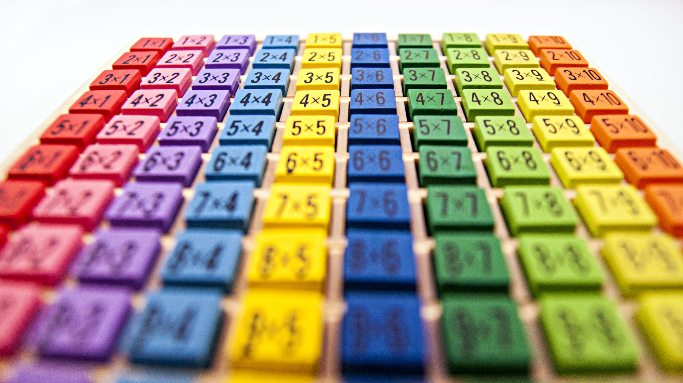
Hand ciphers
Substitution (or “Caesar”) cipher
Jefferson cipher
Playfair cipher
Vigenère cipher
Code book cipher

Slide 12

Why do we encrypt?

Slide 13

What do we encrypt?

Slide 14
How do we encrypt?

Slide 15

Cleartext vs. ciphertext

Slide 16
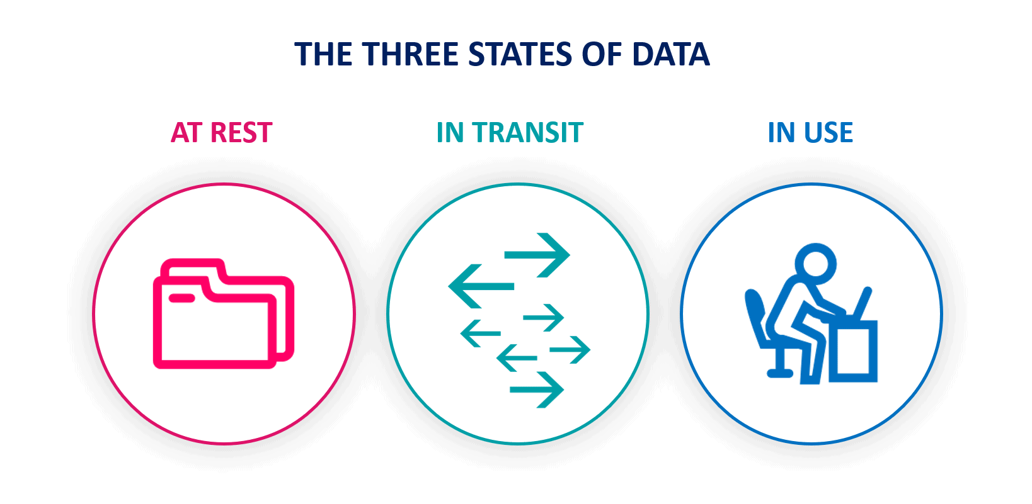
States Of Data

Slide 17
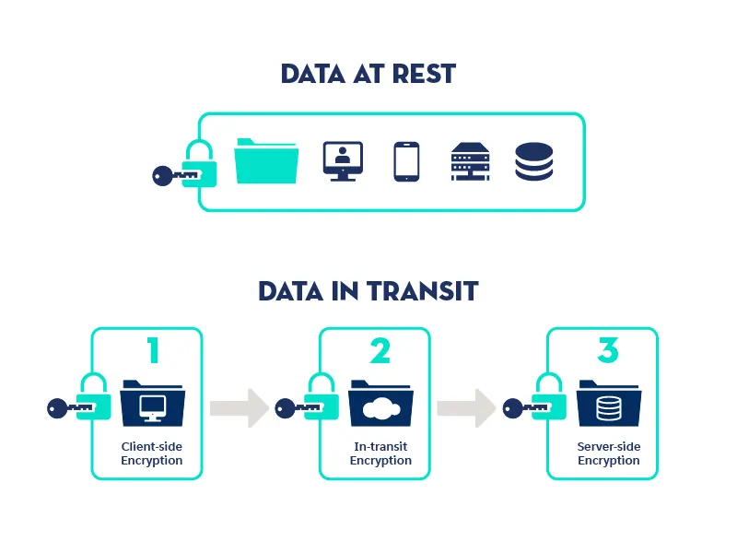
data security

Slide 18
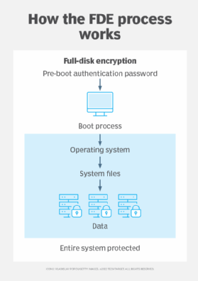
Full disk encryption

Slide 19

Symmetric Key Encryption

Slide 20
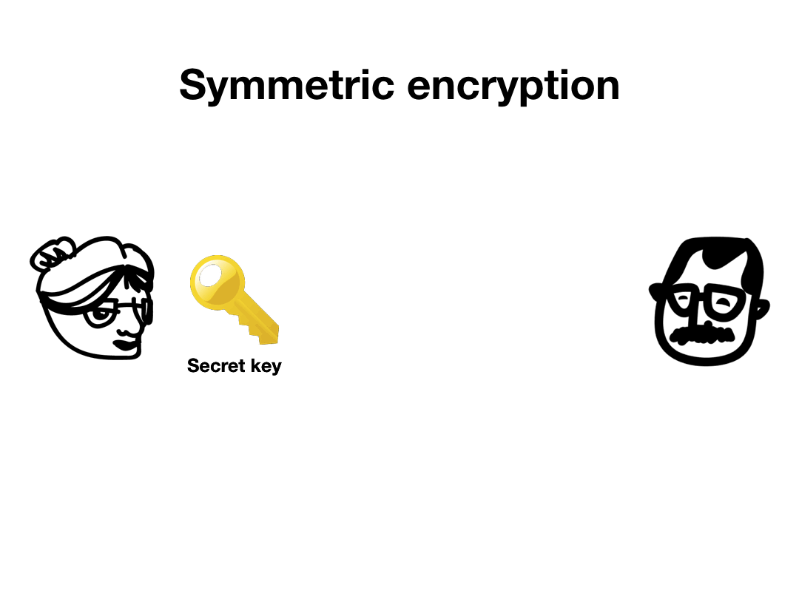

Slide 21

Asymmetric key encryption

Slide 22
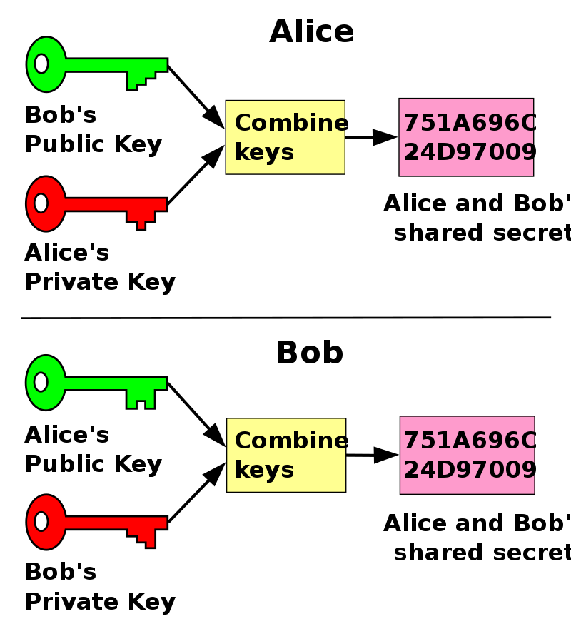
Public key cryptography

Slide 23
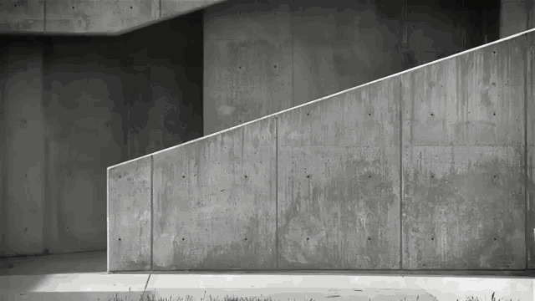
Secure Key Exchange?

Slide 24
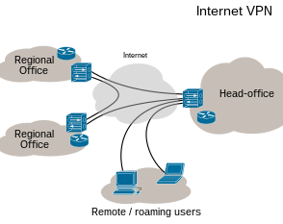
Virtual private networks

Slide 25
Securing network connections in practice

Slide 26
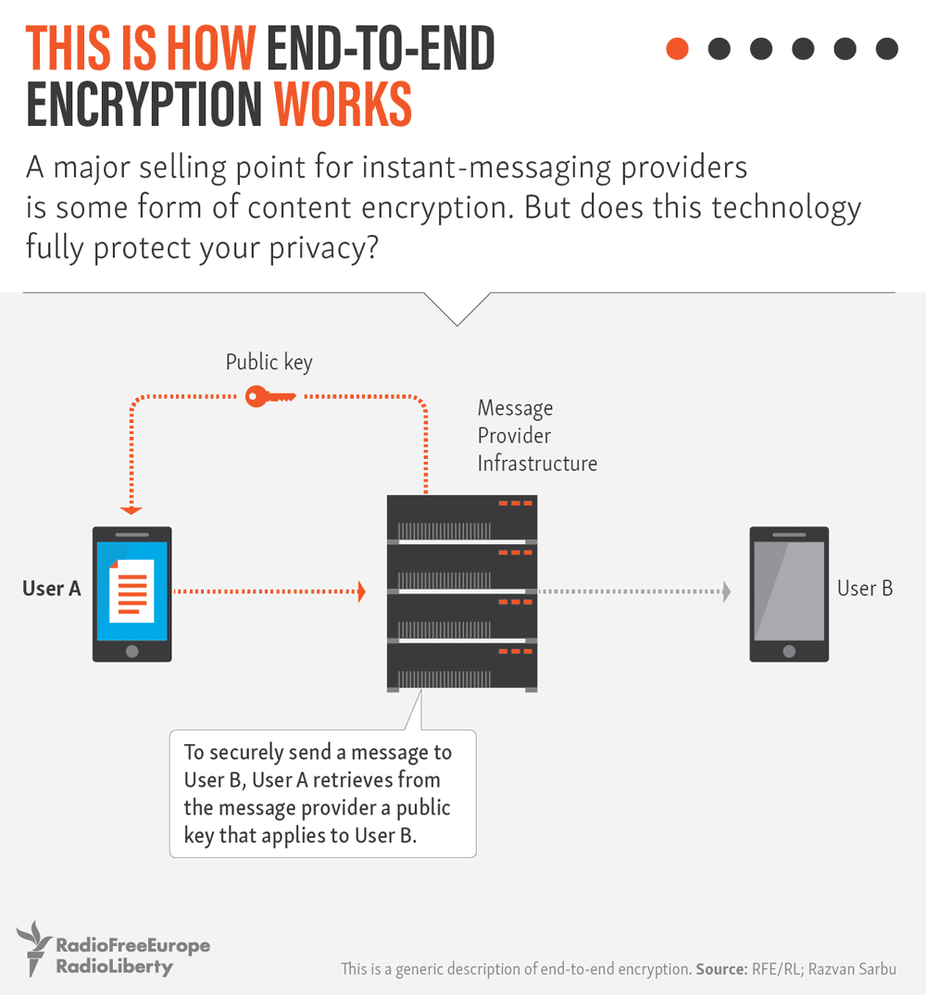

Slide 27
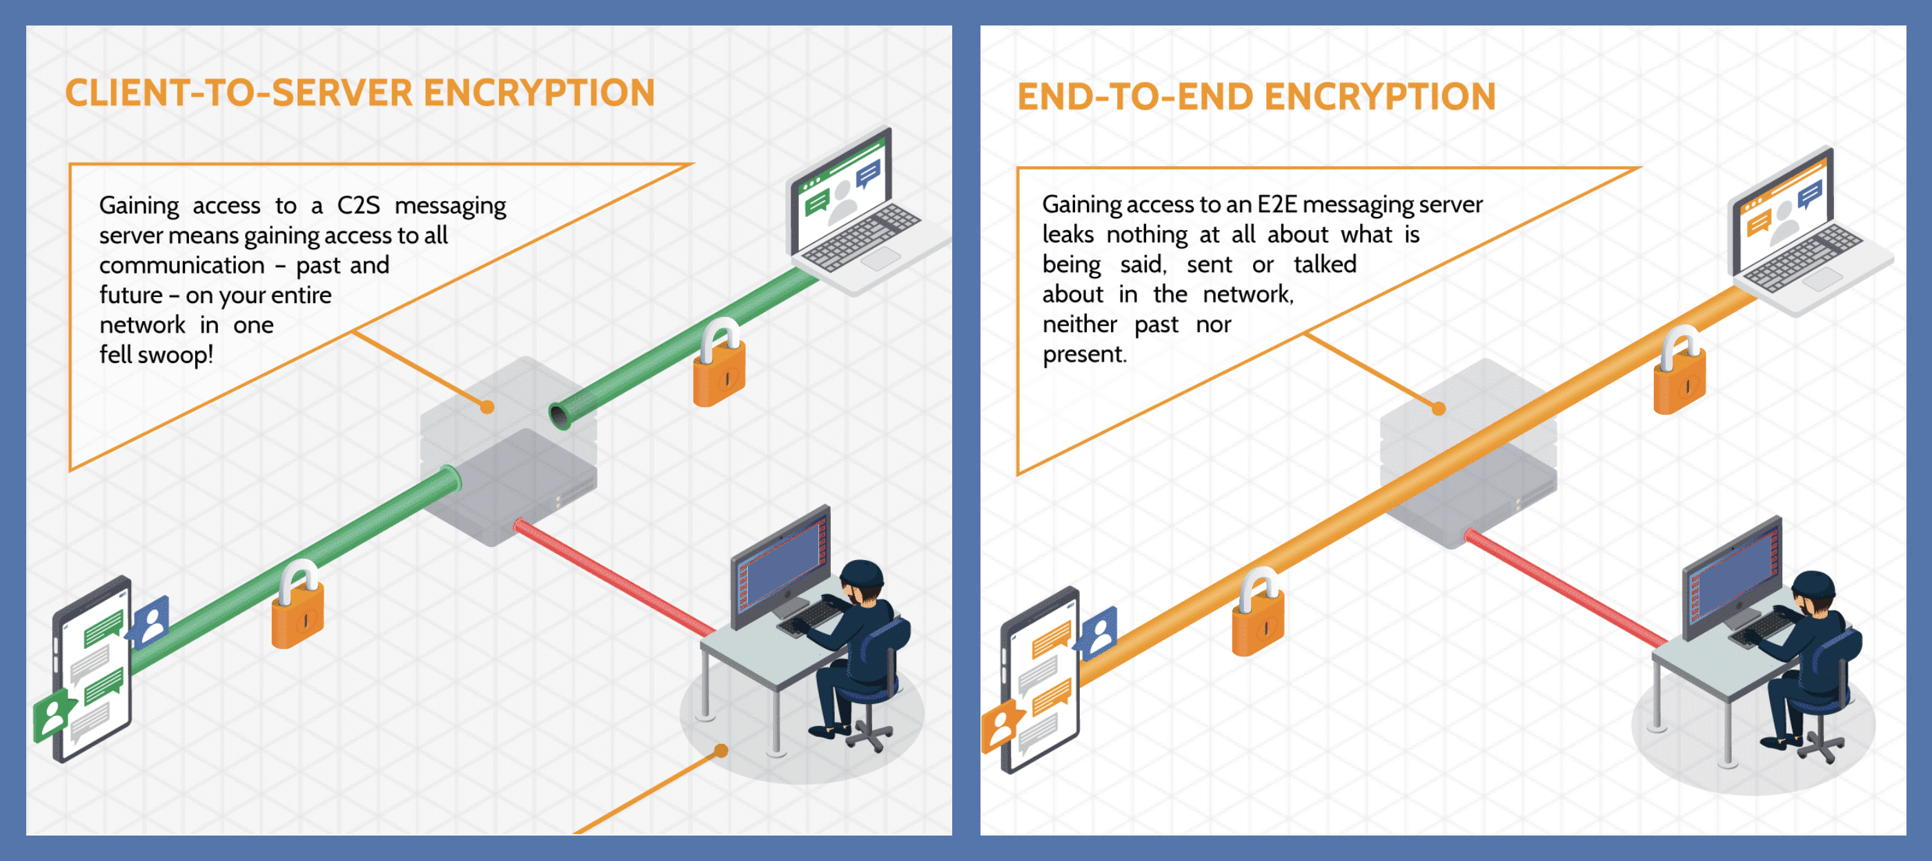
Notes:
The alternative to end-to-end encryption is client-to-server encryption.

Slide 28

Why do we care about trust?

Slide 29
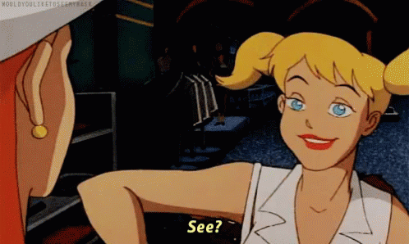
What is a security certificate?

Slide 30
What does a security certificate do?
Provides trust
Allows a secure connection
Encrypts data
HTTPS

Slide 31
Certificate authorities
X.509 certificate
Provides Transport Layer security
Free!
Trusted?

Slide 32
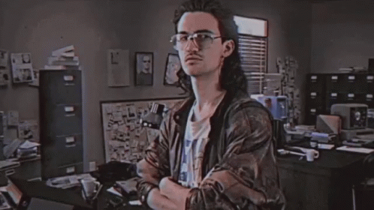
Threats to poor encryption
Password cracking
Man-In-The-Middle (MITM) attack
Rainbow Tables
Hash collisions

Slide 33

Question or clarifications?

Slide 34

Questions?

Slide 35

Review Day 2

Slide 36

Preview day 3

